Slide 1
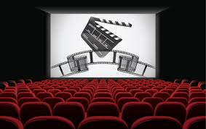

Slide 2


Presented By :
Syeda Sanobar Ali - 22RA1A6673
Mukku Shiva Sai Ganesh - 22RA1A6677
Wasalwar Shiwam - 22RA1A6678
Boga Supriya - 22RA1A6683

Slide 3

Personalized Movie Recommendations: Exploring the MovieLens Dataset
Discover the world of personalized movie recommendations. Dive into the MovieLens dataset, a rich repository of user ratings and movie information, to unlock insights and build intelligent recommendation systems.

Slide 4
ABSTRACT
The development of movie recommendation systems began in the late 1990s with the rise of e-commerce platforms and streaming services. Early methods relied heavily on collaborative filtering, where recommendations were based on user behavior and preferences. In the past, movie recommendations were often made by friends, family, or through movie critics and television programs. People relied on word-of-mouth, printed reviews, and televised recommendations to decide what movies to watch. The traditional system of movie recommendations was limited by a lack of personalization and scalability. It relied heavily on subjective opinions and could not cater to the unique tastes and preferences of individual users, often leading to unsatisfactory movie choices. The motivation behind developing machine learning-based movie recommendation systems is to provide personalized, accurate, and scalable recommendations that enhance user satisfaction and engagement. By leveraging vast amounts of data, these systems can uncover patterns and preferences that are not immediately apparent, offering a more tailored viewing experience. The proposed system for movie recommendations leverages advanced machine learning techniques to provide personalized suggestions. It integrates collaborative filtering, content-based filtering, and hybrid models to analyze user data and predict preferences. Collaborative filtering identifies patterns in user behavior by comparing the preferences of similar users, while content-based filtering analyzes movie attributes such as genre, actors, and directors to match user interests. A hybrid model combines these approaches to enhance recommendation accuracy. User interactions, such as viewing history, ratings, and search queries, are continuously collected and processed. Machine learning algorithms, including matrix factorization and deep learning, are employed to detect latent factors and complex patterns within the data. These models are trained and fine-tuned to improve over time, adapting to evolving user tastes. The system can also incorporate additional data sources, such as social media activity and demographic information, to further refine recommendations. By providing a seamless and personalized viewing experience, this approach enhances user satisfaction and engagement on streaming platforms like Netflix and Amazon Prime.

Slide 5
Exploring the MovieLens Dataset
The MovieLens dataset is a treasure trove of data for building recommendation systems. It contains millions of user ratings for thousands of movies, providing a comprehensive picture of user preferences.
User Ratings
Movie Metadata
User Demographics
The dataset includes user ratings for movies, typically on a scale of 1 to 5 stars.
Movie information, such as title, genre, director, and release year, is included for comprehensive analysis.
Limited user demographics, such as age and gender, can provide valuable insights into user preferences.

Slide 6
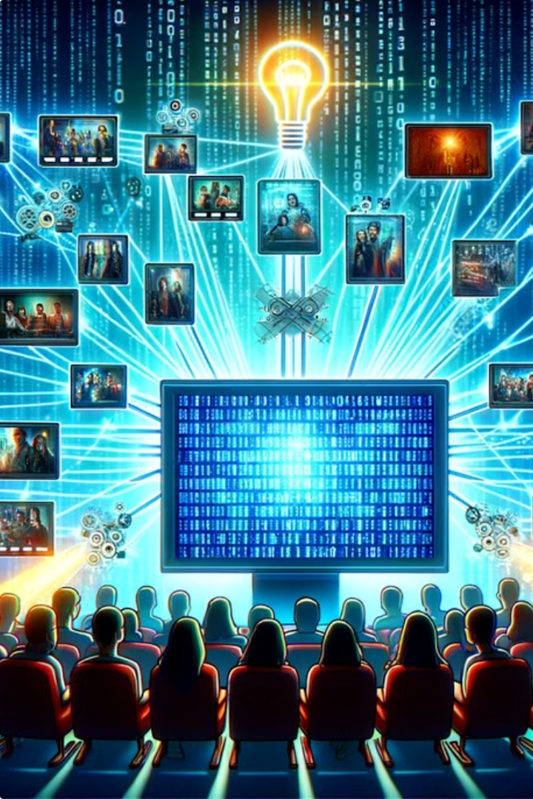
What are recommendations Systems?
Recommender systems are the systems that are designed to recommend things to the user based on many different factors. These systems predict the most likely product that the users are most likely to purchase and are of interest to. Companies like Netflix, Amazon, etc. use recommender systems to help their users to identify the correct product or movies for them.
The recommender system deals with a large volume of information present by filtering the most important information based on the data provided by a user and other factors that take care of the user’s preference and interest. It finds out the match between user and item and imputes the similarities between users and items for recommendation.

Slide 7

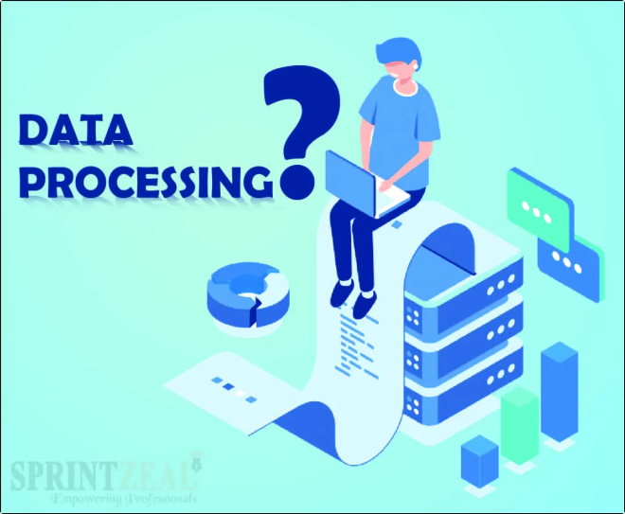
Data Preprocessing and Cleaning
Before embarking on building a recommendation system, meticulous data preprocessing is crucial. This step ensures data quality, consistency, and prepares the dataset for analysis.
1
Handling Missing Data
Missing ratings can be addressed using techniques like imputation, replacing missing values with estimated values.
2
Data Normalization
Scaling data to a common range, such as 0 to 1, can improve the performance of some algorithms.
3
Outlier Detection
Identify and remove extreme values that may distort the results of analysis, ensuring data accuracy.

Slide 8

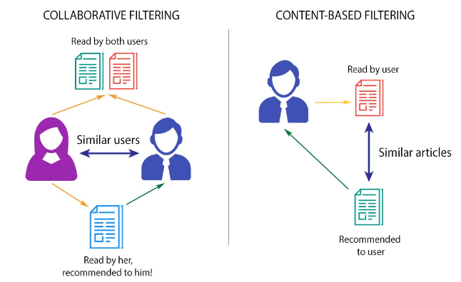
Types of Recommendation Systems?
Content-Based Recommendation System : It is a type of recommendation system which works on the principle of similar content. If a user is watching a movie, then the system will check about other movies of similar content or the same genre of the movie the user is watching. There are various fundamentals attributes that are used to compute the similarity while checking about similar content.
Collaborative Filtering : It is considered to be one of the very smart recommender systems that work on the similarity between different users and also items that are widely used as an e-commerce website and also online movie websites. It checks about the taste of similar users and does recommendations.

Slide 9

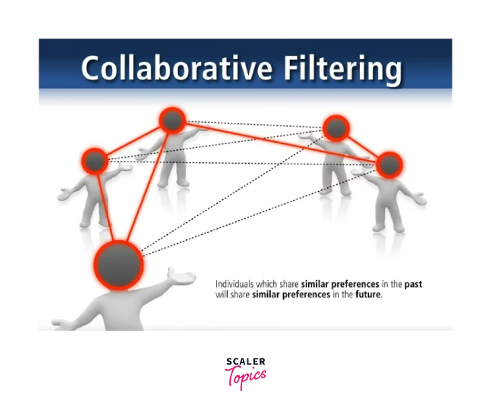
Collaborative Filtering Techniques
Collaborative filtering techniques leverage user-item interactions to generate recommendations. They find users or items similar to a given user or item and recommend items based on their shared preferences.
1
User-Based Filtering
2
Item-Based Filtering
This approach finds users with similar tastes and recommends items liked by those users.
This approach identifies items similar to those a user has liked and recommends similar items.
3
Matrix Factorization
This technique decomposes a user-item rating matrix into latent factors representing user preferences and item characteristics.

Slide 10

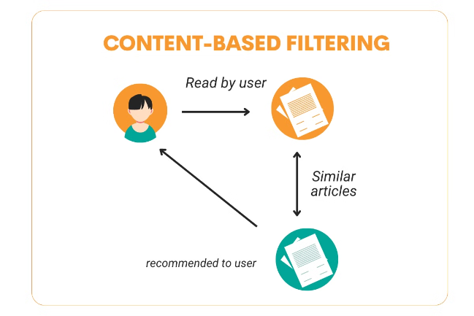
Content-Based Filtering Approaches
Content-based filtering relies on the characteristics of items to generate recommendations. It analyzes the content of items a user has liked and recommends similar items based on shared attributes.
Genre
Director
Recommending movies of the same genre as those a user has enjoyed.
Suggesting movies by the same director, leveraging a user's affinity for a particular director's style.
Actors
Recommending movies featuring actors a user has appreciated in the past.

Slide 11
How to Build a Movie Recommendation System?
Once we’ve discussed the basics of film recommendation engines in machine learning, we can move on to building an actual movie recommendation system. So, we need to build an engine that learns and recognizes patterns in a user’s viewing history before using these patterns to generate new recommendations. What’s required for this?
Data. ML systems need data, so find and import the essential libraries with movie datasets that already have global ratings.
Analysis. Create generic recommendations of top-rated movies from the existing dataset.
Personalization. Get personalized ratings by providing your own movie scores.
Strategy. Implement content-based or collaborative filtering strategy.
Combination. Combine recommendation lists to get a reasonable estimate across the ratings. The combined dataset of movie ratings can now be used for either filtering model.

Slide 12

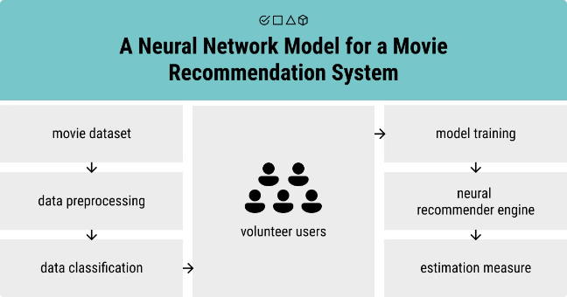
How to Create a Neural Network Model in a Movie Recommendation System?
The importance of artificial neural networks (ANNs) has been frequently discussed before when we talked about image classification, speech recognition, and other issues in AI. Neural networks are well-suited to help humans solve problems and challenges in real-life scenarios by improving decision-making processes in different areas. Cinematography is one of them.
A neural network model, in this case, consists of three layers:
Input. The first layer of a neural network model, where the movie and user vectors are selected as input.
Embedding. The second layer contains embeddings for both movies and users. They are updated during the model training to get the best values of these embeddings and lower the error rate between actual and predicted values.
Output. The final third level generates the predicted values and can consist of one or more neurons provided by the user to the movie.

Slide 13


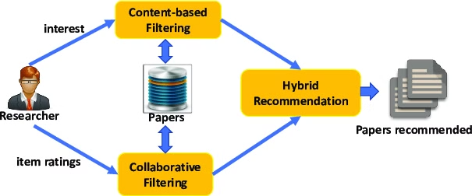


Hybrid Recommender Systems
Hybrid recommender systems combine the strengths of both collaborative and content-based filtering approaches. This integration enhances recommendation accuracy and addresses limitations of individual approaches.
Collaborative Filtering
Provides recommendations based on user-item interactions.
Content-Based Filtering
Leverages item characteristics for recommendation generation.
Hybrid System
Combines both approaches to provide more comprehensive recommendations.

Slide 14




Leveraging Word Cloud Visualization
Word clouds provide a compelling visual representation of the most frequent words in a text corpus. This technique can be utilized to visualize popular movie genres, revealing user preferences and trends.
Genre Popularity
Trend Analysis
Personalized Recommendations
Identify the most frequently occurring movie genres in the dataset.
Observe trends in genre popularity over time, providing insights into evolving preferences.
Tailor recommendations to individual users based on their preferred genres.

Slide 15
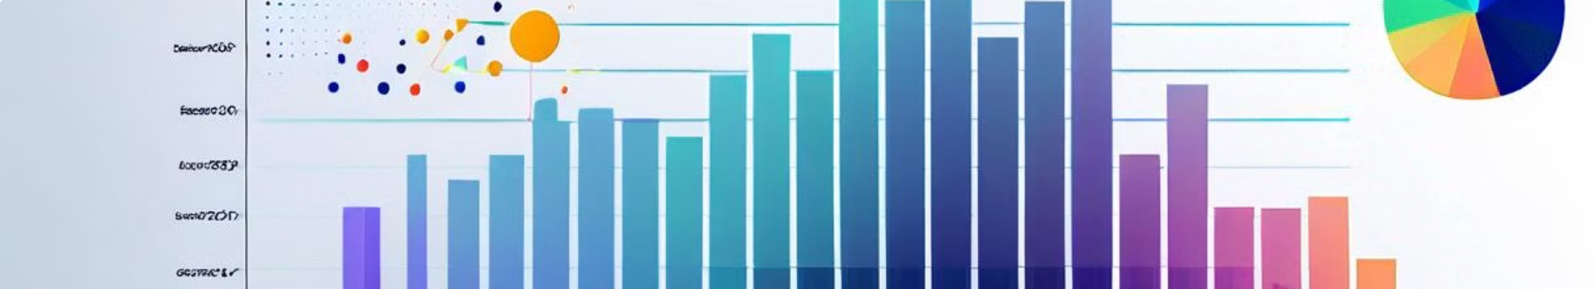
Evaluating Recommendation Performance
Evaluating recommendation performance is crucial to ensure the effectiveness and accuracy of recommender systems. Various metrics are employed to assess the quality of recommendations.
Precision
The percentage of recommended items that are relevant to the user.
Recall
The percentage of relevant items that are recommended.
F1 Score
The harmonic mean of precision and recall, providing a balanced measure of performance.

Slide 16
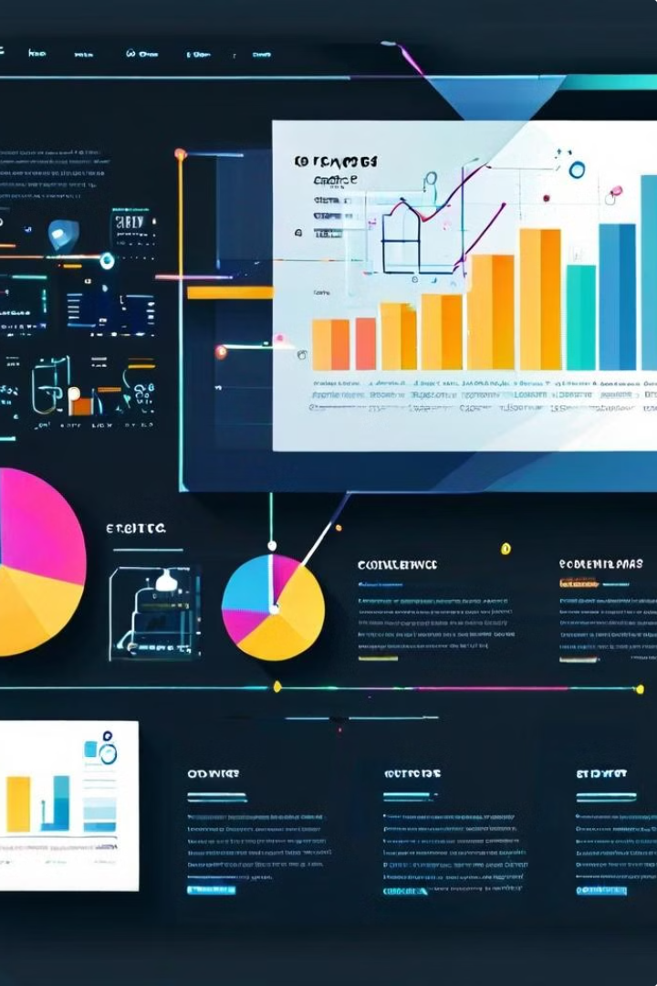
key components on Movielens Recommendations
Key Components:
Understanding the MovieLens Dataset Dataset Overview: Familiarize yourself with the MovieLens dataset, which typically includes movie ratings, movie metadata (titles, genres), and user data. Data Exploration: Perform exploratory data analysis (EDA) to understand the distribution of ratings, genre popularity, and user preferences.
Preprocessing the Data Data Cleaning: Handle missing values, outliers, and duplicate entries. Feature Engineering: Create features such as user preferences, movie popularity, and genre information. Text Processing: Extract relevant textual data (e.g., movie titles, descriptions) for word cloud visualization.
Developing the Recommendation System Algorithm Choice: Decide on the recommendation approach (e.g., collaborative filtering, content-based filtering, or a hybrid model). Implementation: Develop and train the recommendation model using libraries like Surprise, TensorFlow, or scikit-learn. Evaluation Metrics: Use metrics such as RMSE (Root Mean Squared Error), precision, recall, and F1 score to evaluate the model’s performance.

Slide 17

Challenges and Limitations
Recommender systems face various challenges, including data sparsity, cold-start problems, and the risk of recommending overly similar or predictable items.
1
Data Sparsity
2
Cold-Start Problems
Limited user ratings can make it difficult to find similar users or items for accurate recommendations.
Recommending items for new users or newly added items with limited interaction data poses a significant challenge.
3
Overly Similar Recommendations
Recommending only familiar items can lead to a lack of discovery and hinder user engagement.

Slide 18
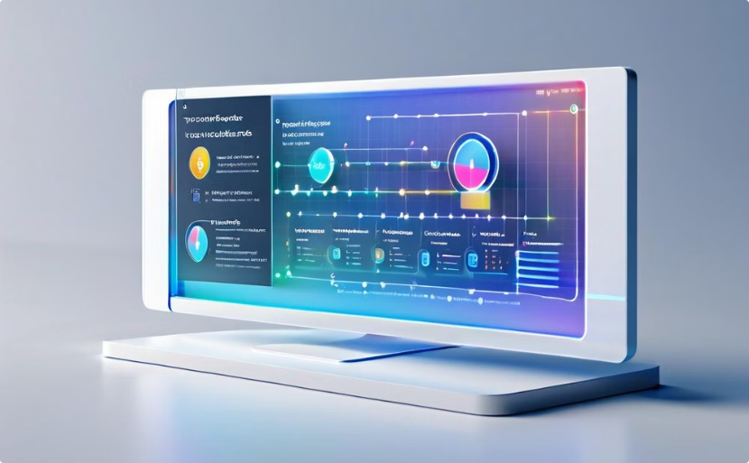

Conclusion and Future Directions
Personalized movie recommendation systems play a pivotal role in enhancing user experience and driving engagement. Future research focuses on addressing existing challenges and exploring novel approaches for improved recommendation accuracy and diversity.
Real-Time Recommendations
Immersive Recommendations
Developing systems that provide dynamic recommendations based on real-time user activity and preferences.
Integrating recommendation systems into virtual reality and augmented reality platforms for enhanced user engagemen

Slide 19
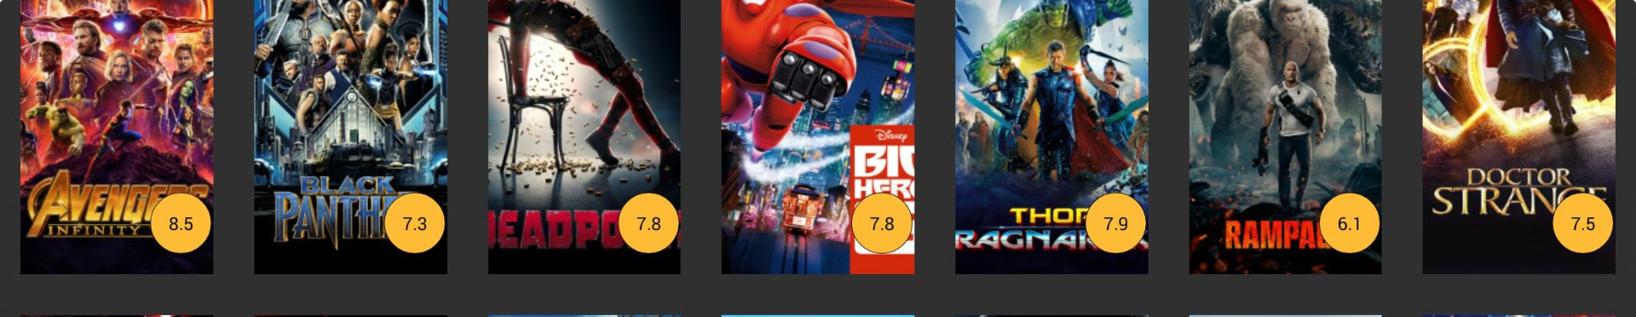
THANK YOU

